Slide 1
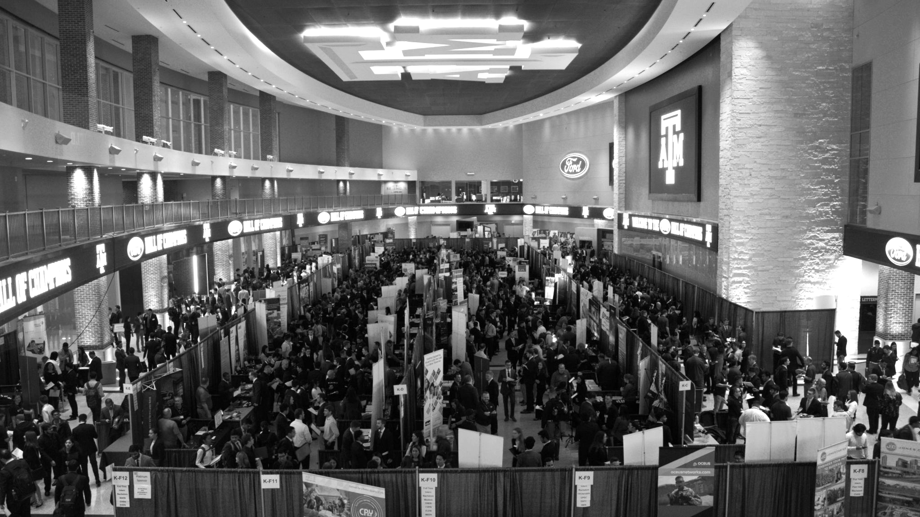

LANL Team Week 3 Project Update
1/29/2025
Izzy Baumler, Dalton Boeckmann, Morgan Gullo, Jade Waldron

Slide 2
Problem Statement/Project Motivation
There is a need for a technology that has 6 DOF and can move through its full range of motion in each degree of freedom of at least 1 Hz.

Slide 3
Weekly Assigned Tasks
Jade - Refinement of Solidworks Models/Prototyping
Izzy - Prototyping/Motor Research
Dalton - Fastener BOM/Electrical Research
Morgan - Purchase orders/Electrical Research

Slide 4
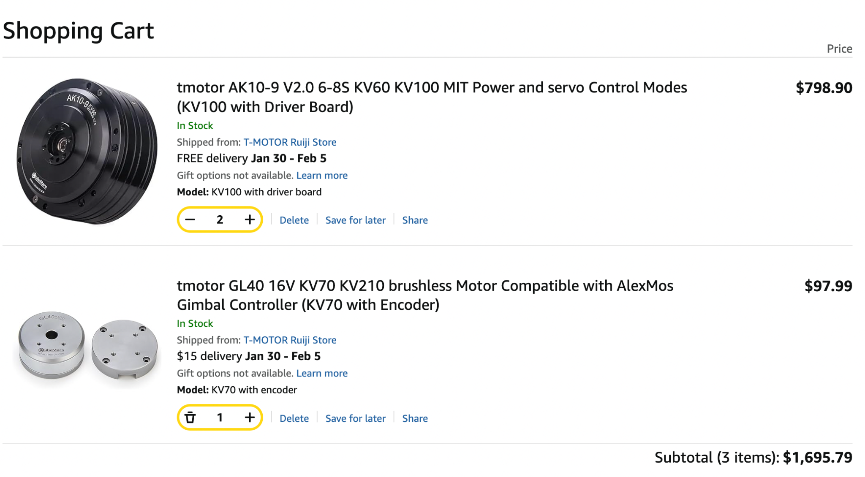
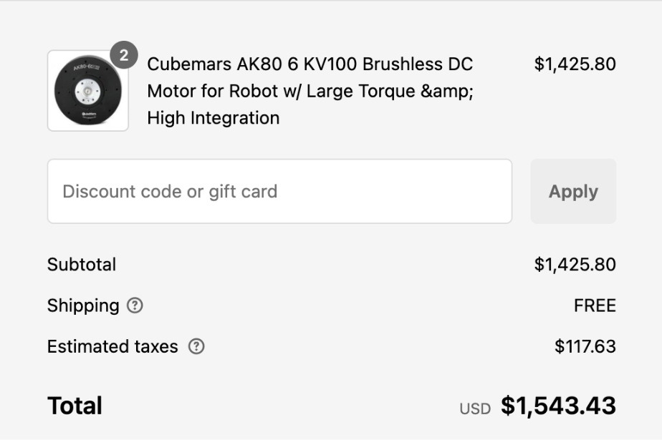
Orders Purchased
Estimated delivery date: January 30th - February 5th

Slide 5
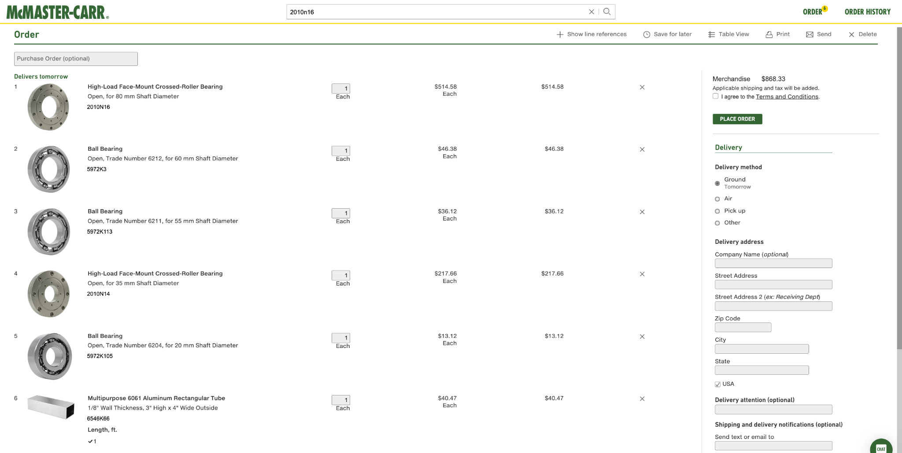
Orders Purchased
Delivered and Picking up today

Slide 6
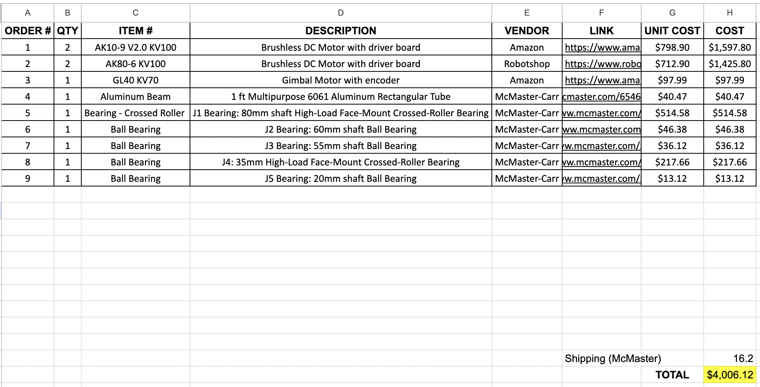
Budget Update

Slide 7
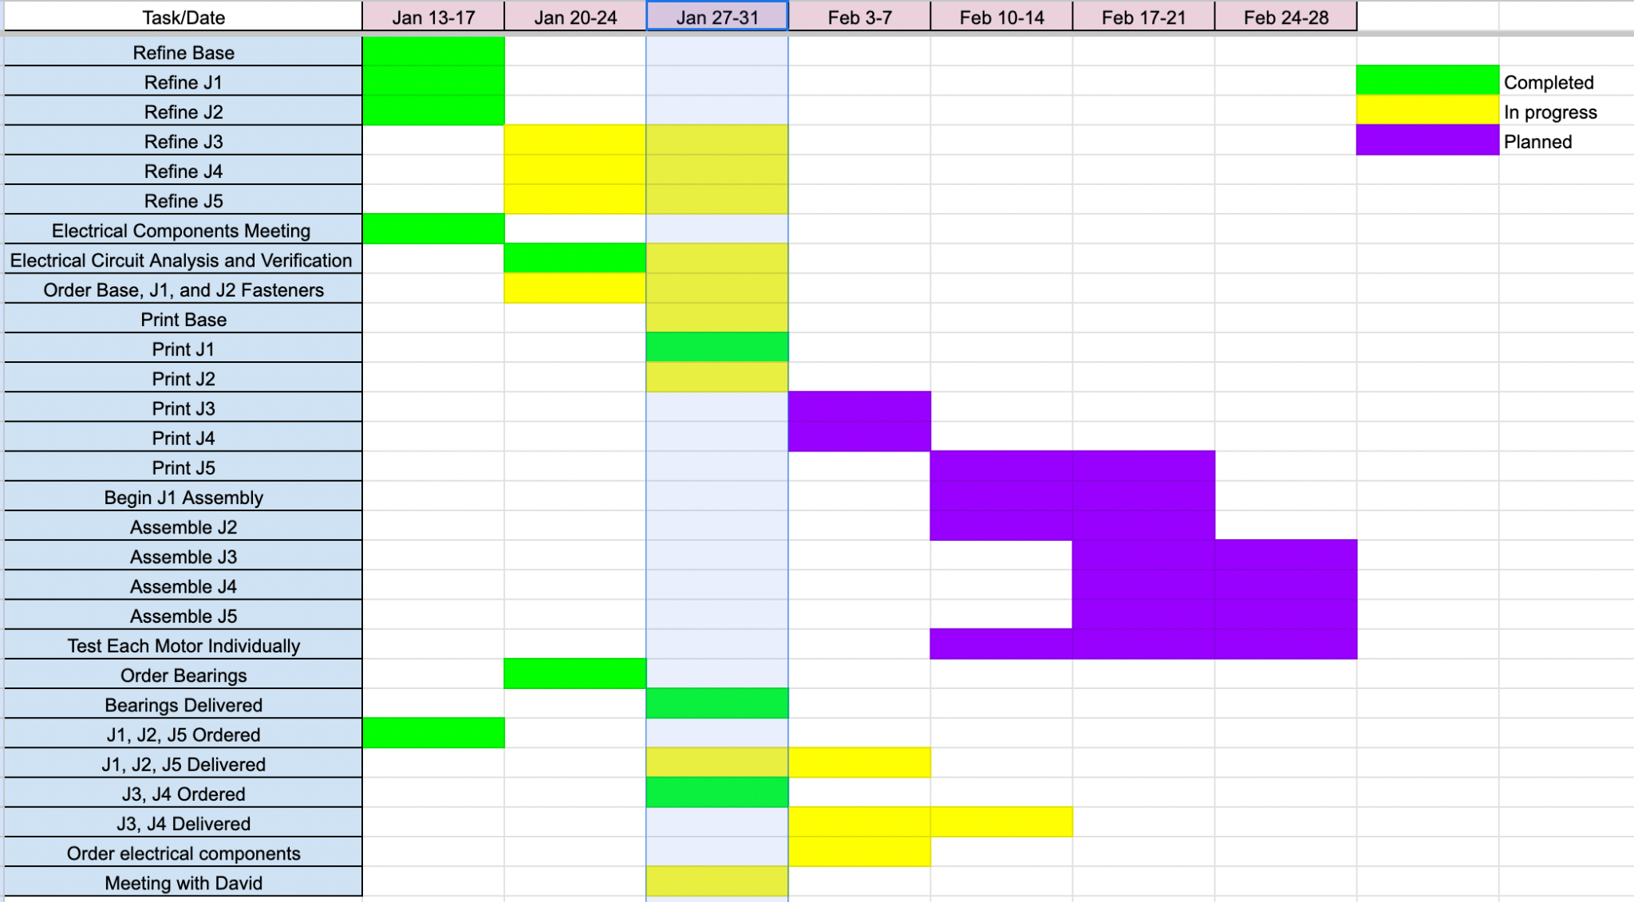
Schedule Update

Slide 8
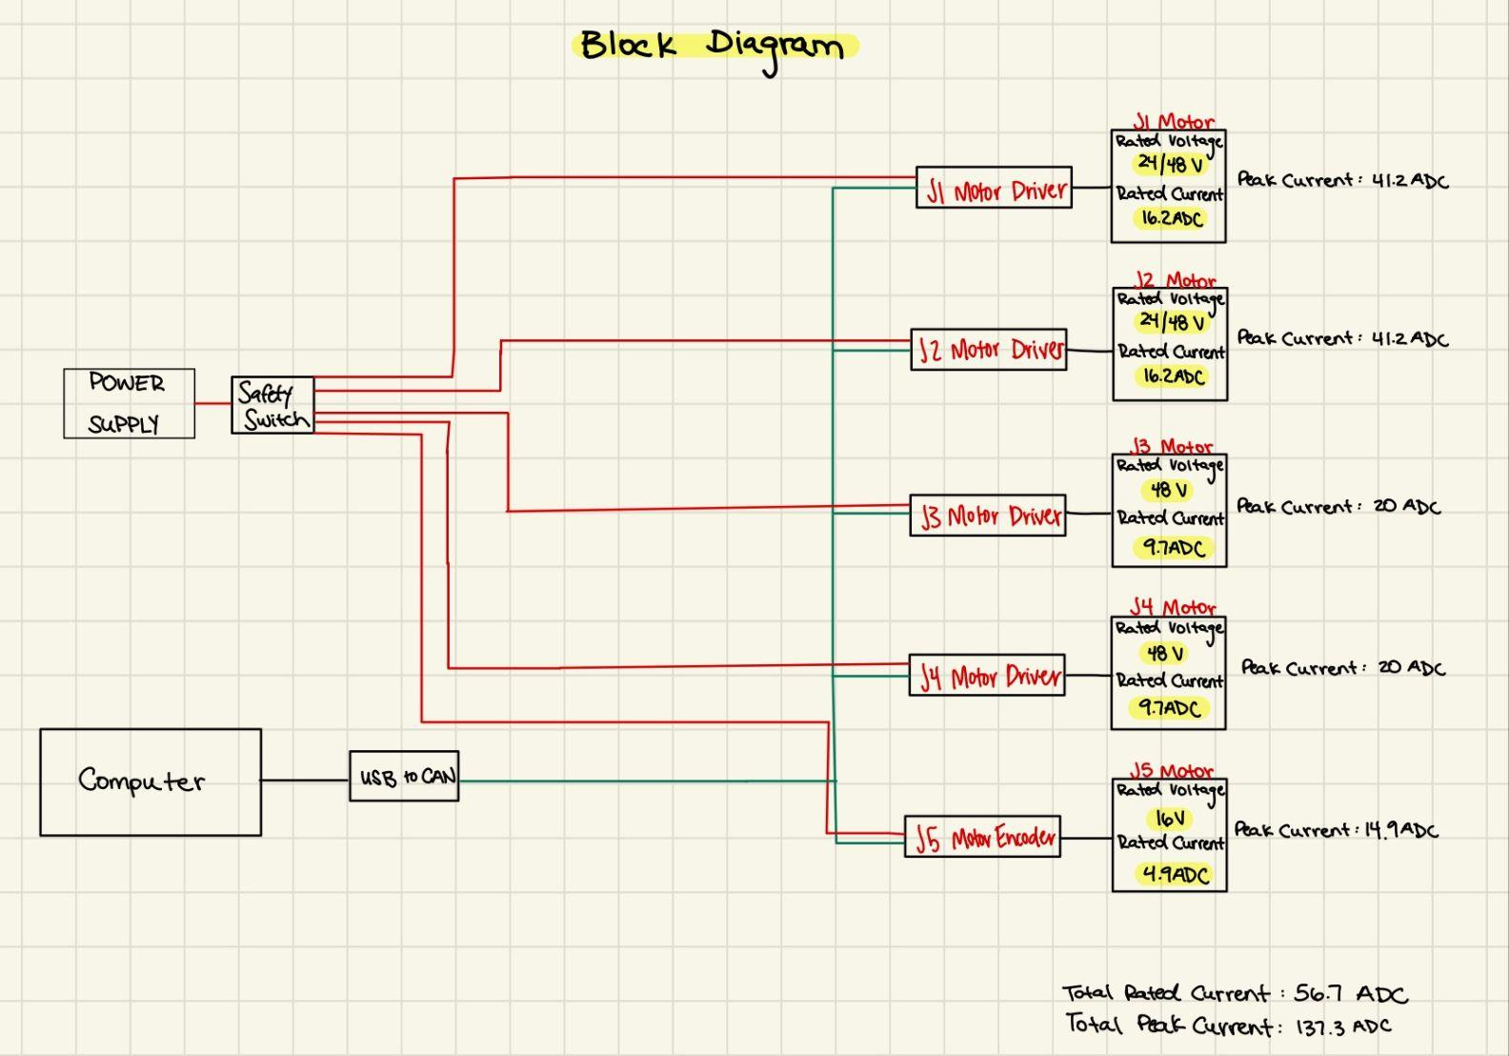
Block Diagram

Slide 9
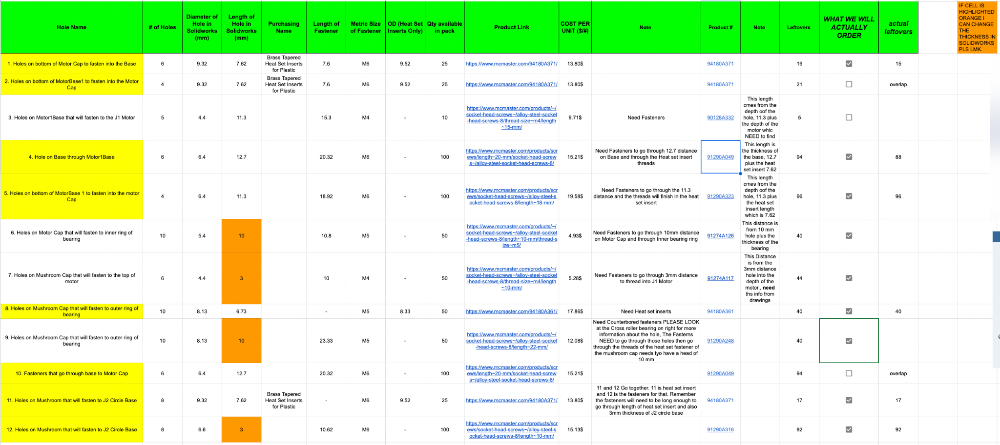
Fasteners

Slide 10
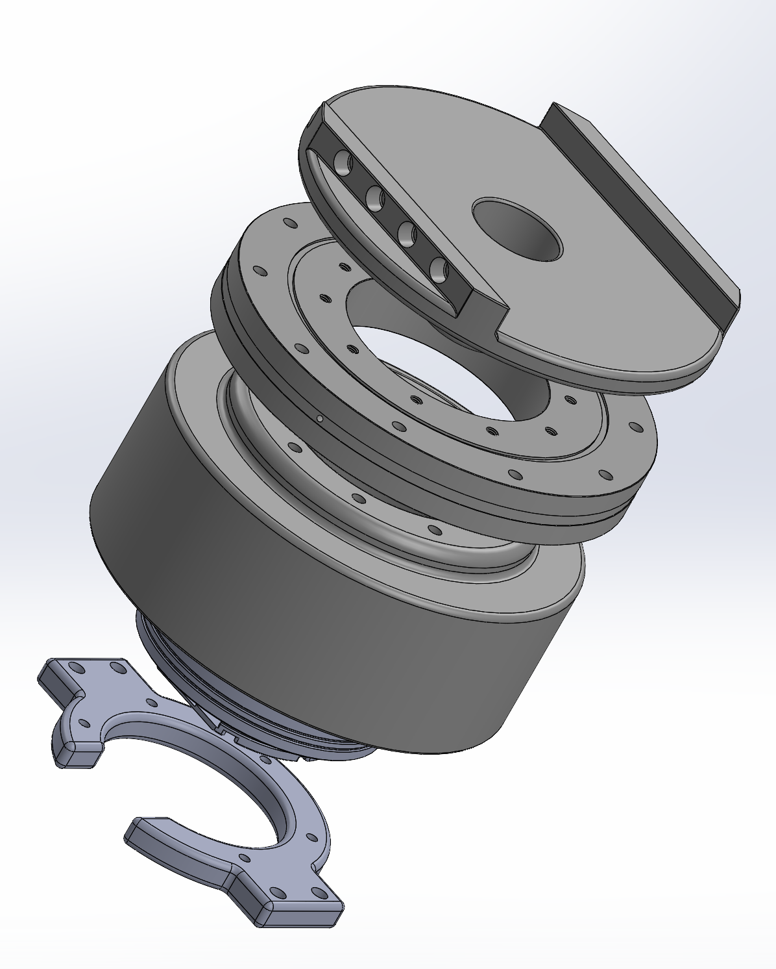
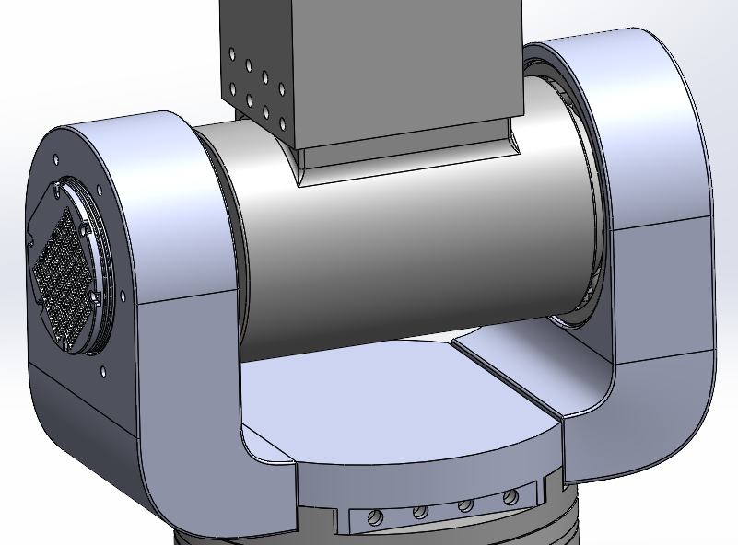
CAD Refinement
Once holes were finalized, fillets were added to finalize the design for 3D printing

Slide 11
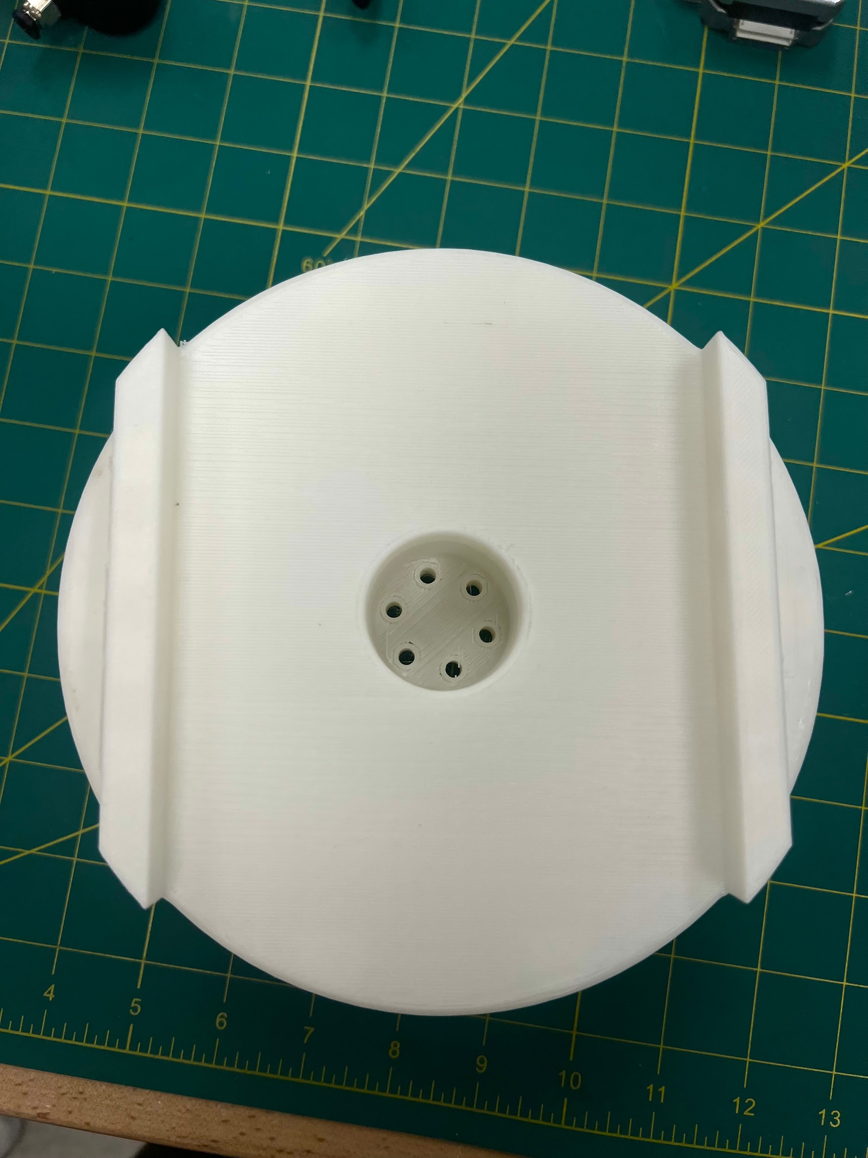
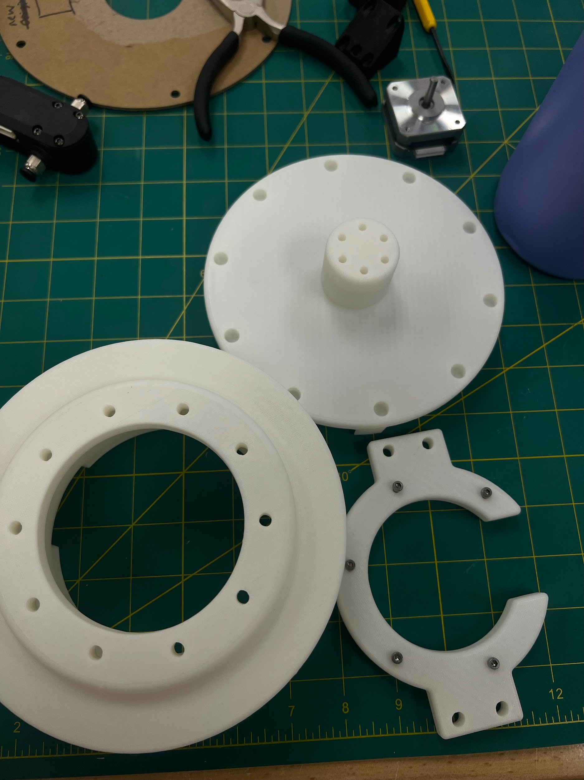
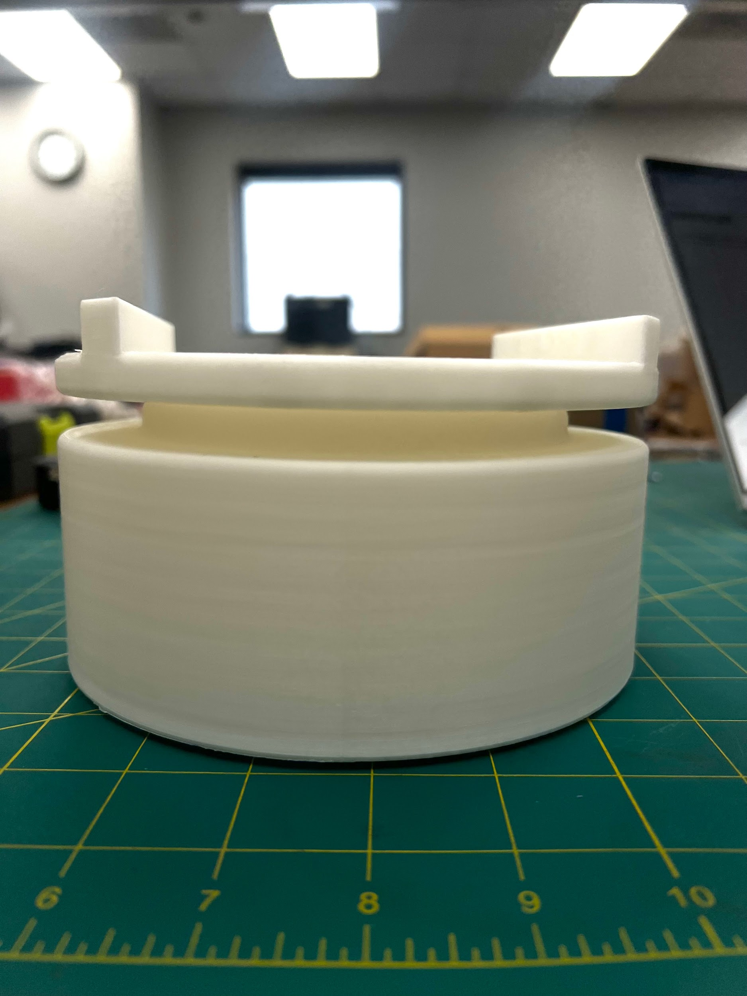
PLA Prints
Printed through RPS
PLA with 15% infill density
Grid infill pattern
Holes were not as accurate as expected
will be increasing size of them to accommodate
All of J2 should be done printing today/tomorrow

Slide 12
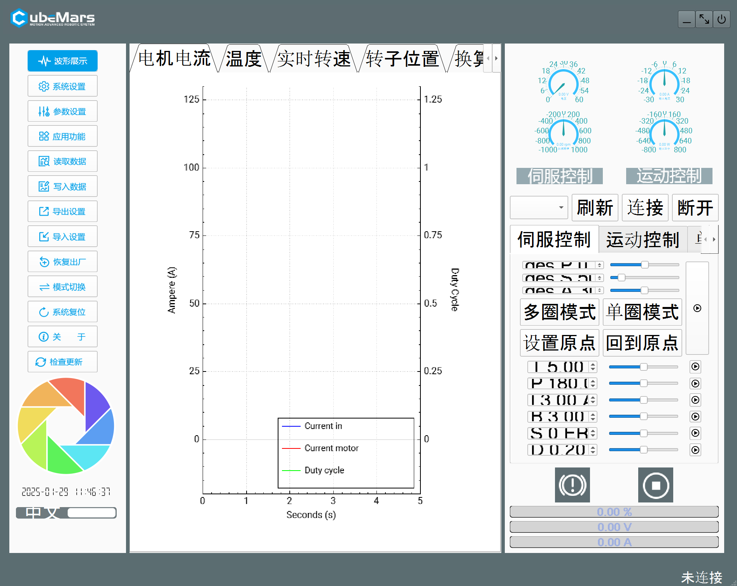
Motor Research
Found playlist on controlling CubeMars motors specifically
“Upper computer software is needed”
Reached out to CubeMars to download software
2 different modes:
MIT mode: Controls one loop at a time
Servo mode: Controls torque and position

Slide 13
Future Assignments
Meeting with sponsor on Friday at 2 PM
Continue refining CAD and prototyping
Continue Selection Process with Fasteners and Ordering
Order electrical components
Begin assembling Base, J1, and J2

